Slide 1
Economic Report of the EU Aquaculture Sector
AAC and MAC
4. and 5. June 2025
Rasmus Nielsen
Professor
University of Copenhagen
rn@ifro.ku.dk

Slide 2
Outline of presentation
Background for the data collection for aquaculture in EU
Content of the report from 2024 (EWG 24-14)
Special chapters
Conclusions

Slide 3
The aim of the data collection under EMFF and EMFAF
The Common Fisheries Policy (CFP) should ensure that fishing and aquaculture activities contribute to long-term environmental, economic, and social sustainability.
Collection and dissemination of aquaculture data is done in order to provide a sound basis for scientific advice in support of the EU Common Fisheries Policy

Slide 4
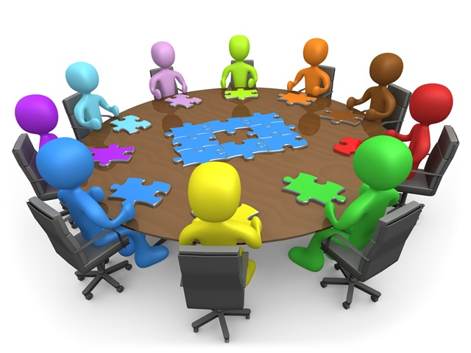
Background
The data collected are specified by Commission regulation
Data are reported by Member States on species and production technique
Important to harmonize the data for comparability (Regional Coordination Group (RCG-ECON))
Data for the years 2008 to 2022 (Additional data from FAO and EUROSTAT)
The report and data are published at JRC website
What is collected
The report give a comprehensive overview of the latest information available on production volume, economic value, employment and competitive performance at the national and EU level for the years 2017 to 2022
Economics – Detailed sales volume, value and cost for aquaculture firms
Social – Socio-demographics on age, gender, education, nationality
Environment – ? (not implemented Mortality and Medicine use)

Slide 5
Contents of the report
An EU overview chapter presenting the current state
Furthermore, the EU sector is divided on
Marine finfish (salmon, seabream/seabass, tuna and other species)
Shellfish (mussels, oysters, clams and other species)
Freshwater (trout, carp and other species)
Special topics:
The economic sustainability indicators
Nowcast estimation of the overall production value and volume and employment of the EU aquaculture sector for 2023
Notes:
The EWG was requested to analyse and comment on
the economic performance of the EU and national aquaculture sectors between 2017 and 2022 (EU-MAP)
produce a nowcast for 2023
Provide a suggestion for economic sustainability indicators

Slide 6
The EU aquaculture sector in numbers (2022)
14 thousand enterprises of which 80% are micro-enterprises (10 employees)
73 thousand employees and 41 thousand full time employees
1.2 million ton is produced, valued at € 4.8 billion
Increase of 5% in volume and 24% in the turnover compared to 2020.
Increase of 1% in volume and 15% in turnover compared to 2021
Notes:
Employment increase is due to integration of UNPAID LABOR in the numbers
Positive development in prices for seafood is driven by inflation, covid and war in Ukraine.
Production volumes driven by slight increase in marine and decline in freshwater fishes and mussels declined.

Slide 7
Main species by weight and value (2022)
Main species by weight are Mediterranean mussels, trout, blue mussels, seabream, oyster
Main species by value are trout, seabass, seabream, tuna, oysters

Slide 8
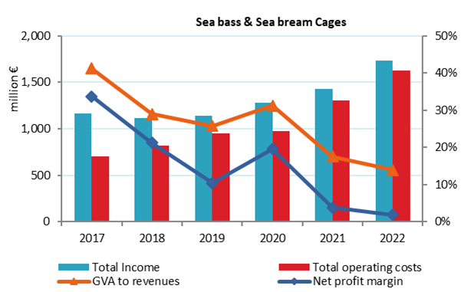
Main results - Marine fish sector 2022
Marine aquaculture cover 48% of the production in terms of value and 25% of the weight
Few species - high specialisation. The sector is capital intensive and have large enterprises.
The largest producer is Greece (seabass/seabream)
It employs around 9,000 persons in 500 enterprises

Slide 9
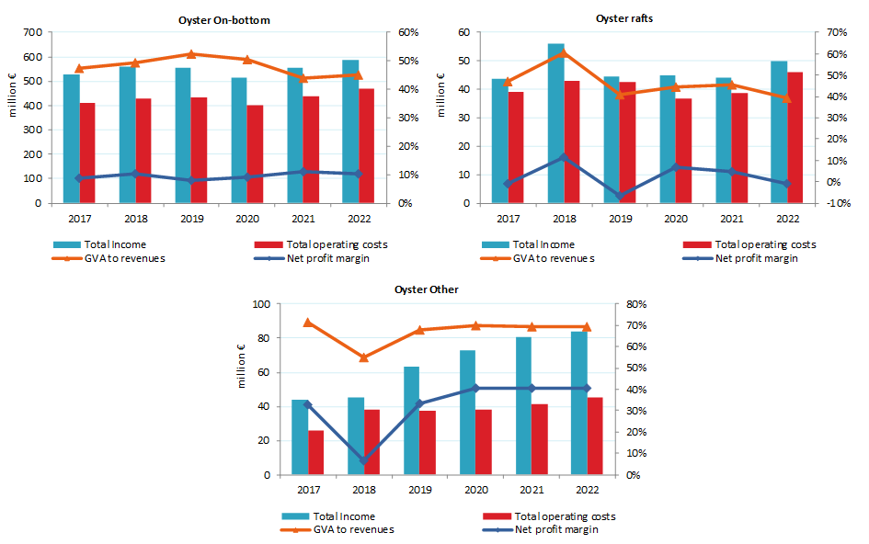
Main results - Shellfish sector 2022
Shellfish cover 28% in value and 48% in volume.
Main producers are Spain, France, Portugal and Italy
Species are Oysters, Mediterranean- and Blue-mussels and Clams
Dominated by small scale family-owned enterprises
The shellfish sector is important in terms of employment covering 38,000 persons, distributed on 6,500 enterprises

Slide 10
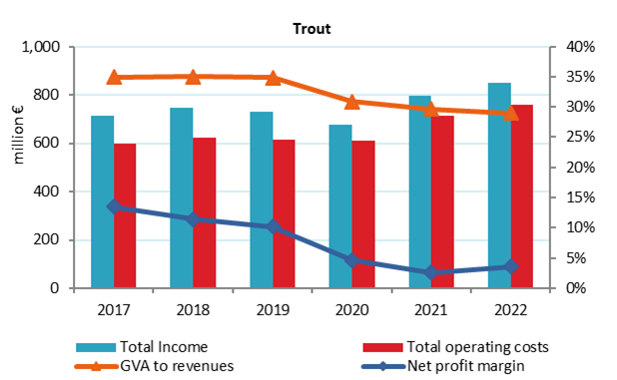
Main results - Freshwater fish sector 2022
Freshwater fish contribute 25% of value and 27% in volume.
Producers are Italy, Denmark, France and Spain
Trout are produced in both intensive and extensive systems
Carp is produced in extensive systems
Small scale family-owned enterprises
Employment 22,000 persons.
Around 6,200 enterprise.

Slide 11
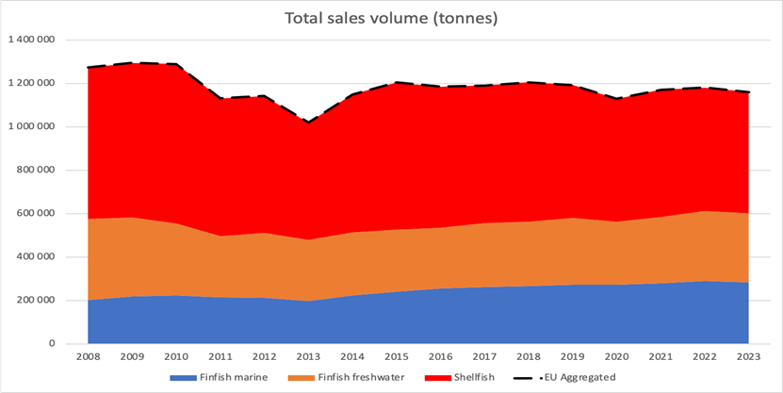
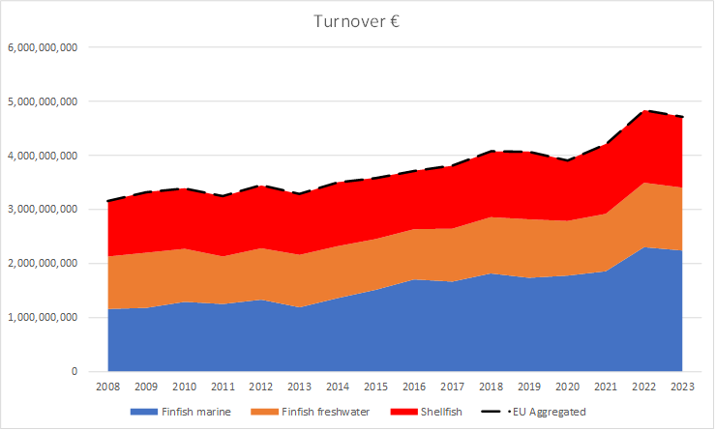
Special Topics – Nowcast model
The nowcast-model only estimate production volume and value along with number of enterprises and employment in the sector
Only 2023 is reported (lack of data for 2024)
Nowcast estimate for 2023 – volume will decrease 2%, and sales value is stable
Estimates for 2021 - within 2% of volume and 5% of sales value

Slide 12
Special Topics – Economic indicators
Economic sustainability
Economic sustainability refers to the ability of an economy or a sector to support a defined level of economic production in the long term.
Long term resilience requires that industries are able to continuously invest in new technology to stay competitive, and at the same time pay for negative externalities (side effects) imposed on society or from use of natural resources.
It is closely linked to the other two pillars of sustainability, social and environmental.

Slide 13
Special Topics – Economic indicators
Economic sustainability
The variables selected for investigating economic sustainability are:
GVA (Gross value added) – Profit before paying labour and capital
EBIT (Earnings before interest, tax) – Profit after paying labour and capital
ROI (Return on investment) – EBIT/Value of assets
FEI (Future expectation) – Positive amount of investment/Value of assets
Labour productivity – GVA/FTE
Capital productivity – GVA/Value of assets
Notes:
Paying labour – wages and saleries
Paying capital - Depreciation =consumption of fixed capital
Future Expectations of the Industry (FEI) = ((Net investment - Consumption of fixed capital)/ (Total value of assets)) *100%

Slide 14
Special Topics – Economic indicators
Economic indicators in The EU aquaculture report
Can be calculated based on reported data
All definitions and calculation is shown in the report
Can easily be interpretated and compared to other statistics
Time series may create problems (DCF/EUMAP)(missing countries)
Knowledge on species and segments is important for valid calculations
Conclusion: Overall, the EU aquaculture sector seems economically robust!
Total aquaculture | 2017 | 2018 | 2019 | 2020 | 2021 | 2022 | 2017-22
GVA (€ million) | 1487 | 1431 | 1411 | 1414 | 1589 | 1633 | 10%
EBIT (€ million) | 538 | 423 | 364 | 428 | 556 | 522 | -3%
ROI (%) | 10% | 7% | 6% | 7% | 8% | 8% | -22%
FEI (%) | 3% | 4% | 2% | 2% | 3% | 3% | -4%
Labour productivity (thousand €) | 52 | 51 | 47 | 50 | 51 | 48 | -8%
Capital productivity (%) | 27% | 25% | 22% | 22% | 23% | 24% | -12%

Slide 15
Special Topics – Economic indicators
Example from the report:
Trout all technologies
Species and technique
Start year matters
Countries included
More analysis needed to look at longer time series
Sustainable economic indicators of EU trout aquaculture: 2017-22.
New Trout | 2017 | 2018 | 2019 | 2020 | 2021 | 2022 | Variation
GVA (€ million) | 209.7 | 221.3 | 222.0 | 186.9 | 206.1 | 207.6 | -1%
EBIT (€ million) | 58.6 | 65.9 | 59.2 | 27.3 | 15.9 | 14.0 | -76%
ROI (%) | 8% | 10% | 8% | 4% | 1% | 2% | -79%
FEI (%) | 6% | 13% | 8% | 7% | 3% | 3% | -51%
Labour productivity (thousand €) | 49.7 | 52.5 | 53.6 | 46.5 | 38.7 | 38.1 | -23%
Capital productivity (%) | 30% | 33% | 32% | 27% | 19% | 26% | -14%

Slide 16
Special Topics – Economic indicators
Economic sustainability
New insights on global aquaculture production using the aquaculture performance index show that on average aquaculture production is able to support all three pillars of sustainability simultaneously if managed properly (Garlock et al., 2024).
To this end, the European aquaculture sector (including UK and Norway) is performing better in all dimensions compared to global averages (Nielsen et al. 2025).

Slide 17
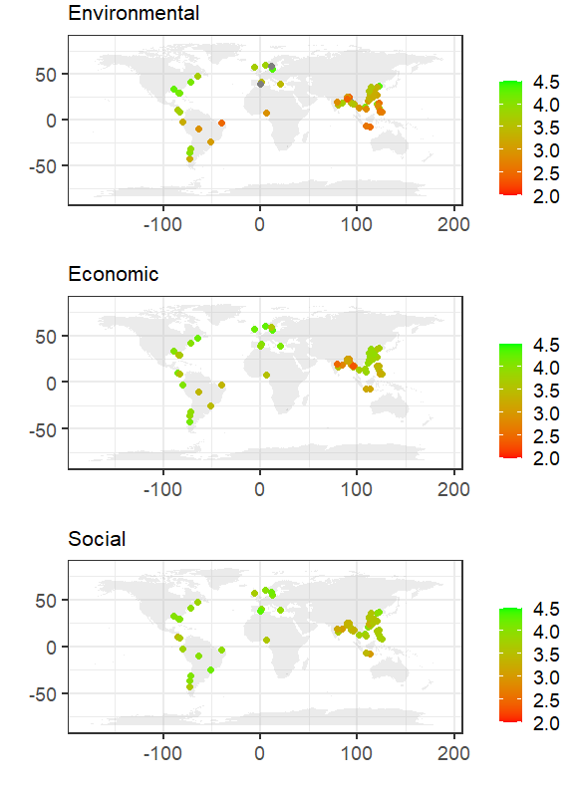
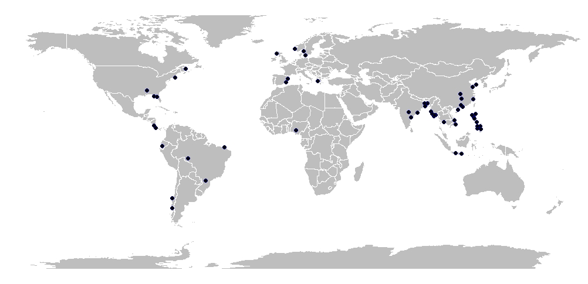
Special Topics – Economic indicators The Aquaculture Performance Indicators (API)
At a global scale, the Aquaculture Performance Indicators, include 58 case studies in 21 countries, representing 91% of global production.
API have 88 output indicators that can be aggregated into the 3 pillars of sustainability.
Notes:
Each indicator is measured on a Likert-scale with 5 being very good and 1 being very bad.
To the right you can see the 58 case studies scores in each dimension

Slide 18
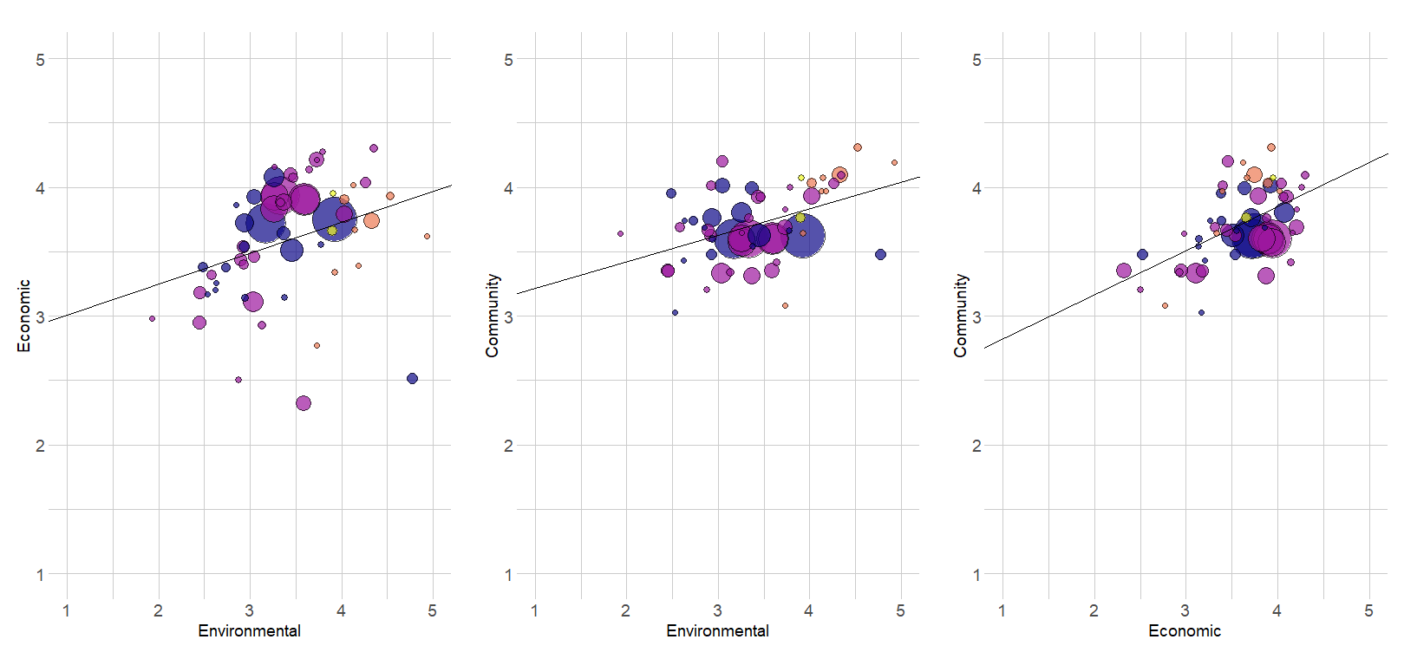
Special Topics – Economic indicators A positive correlation between all three pillars of sustainability
r = 0.33
r = 0.45
r = 0.55
Size of bubble represents production value
Notes:
The main result show that there are a positive correlation between Environmental, Economic and Social sustainability within global aquaculture production.
The better performance in one dimension also support better performance in the other dimensions.
It makes sense - because the producers are dependent on good environmental condition for future production.
Furthermore, producers are dependent on local labor and social acceptance to be able to produce.

Slide 19
Special Topics – Economic indicators
EUROPEAN COURT OF AUDITORS - conclude
“The allocation of funding was thus mainly demand-driven, with little strategic focus on using funding as a tool to support EU aquaculture policy and the member states’ plans for aquaculture.”
In the EU Economic Aquaculture report from 2016, the effects of EU subsidies was analyzed and it was concluded.
“It still seems that providing better framework conditions for the aquaculture industry is by far the most important issue to solve - to lay the foundation for future growth in the European aquaculture sector - than providing public funding to individual entrepreneurs.”
A lot more attention on how subsidies are used is needed
More research on where there are positive effects of using subsidies
More research on identifying and removing barriers to growth in EU

Slide 20
Conclusions
The overall information on the EU sector has improved
More freshwater aquaculture covered
The Nowcast estimations and alternative data sources, allows for bridging data gaps and present time trends
On the other hand
Lack of data control before meetings
Lack of data experts and correction of data during the meeting decrease time for economic analysis and thereby quality of the report
Collection of environmental variables (Mortality and Medicine)?
Nitrogen and phosphorus instead?
Cooperation with stakeholders could be improved
More expects and observers

Slide 21
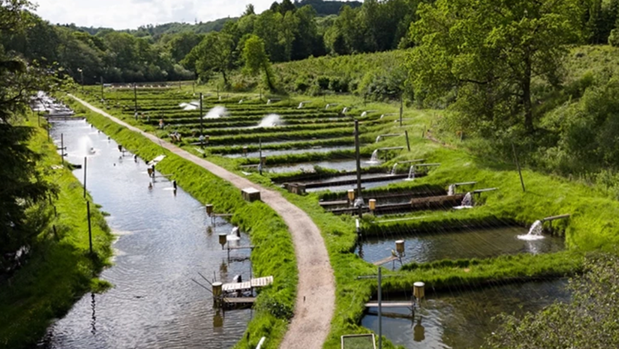
Thank you
Thank you
Rasmus Nielsen

